Slide 1
24MAT120
S2 P & M

Slide 2
Suppose fluid flows in a region.
Can we relate what happens INSIDE a region to what happens on its BOUNDARY?
This is the core idea of Green’s theorem.
Line integral : measures total behaviour around boundary
Double integral : measures local behaviour inside region
Green’s theorem connects these two.

Slide 3
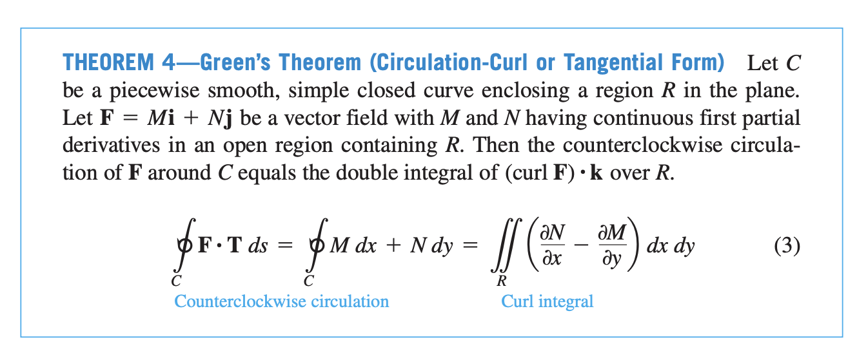
Green’s Theorem

Slide 4
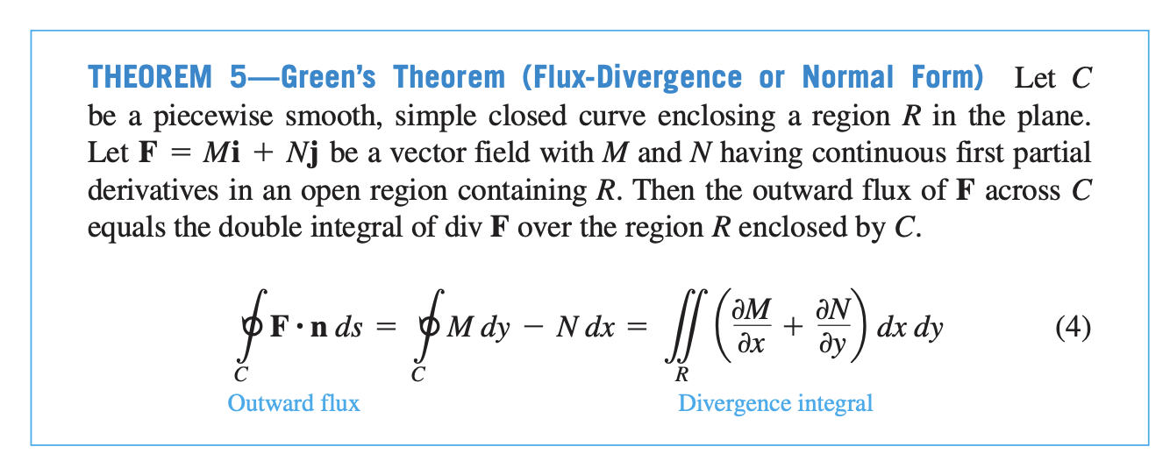

Slide 5
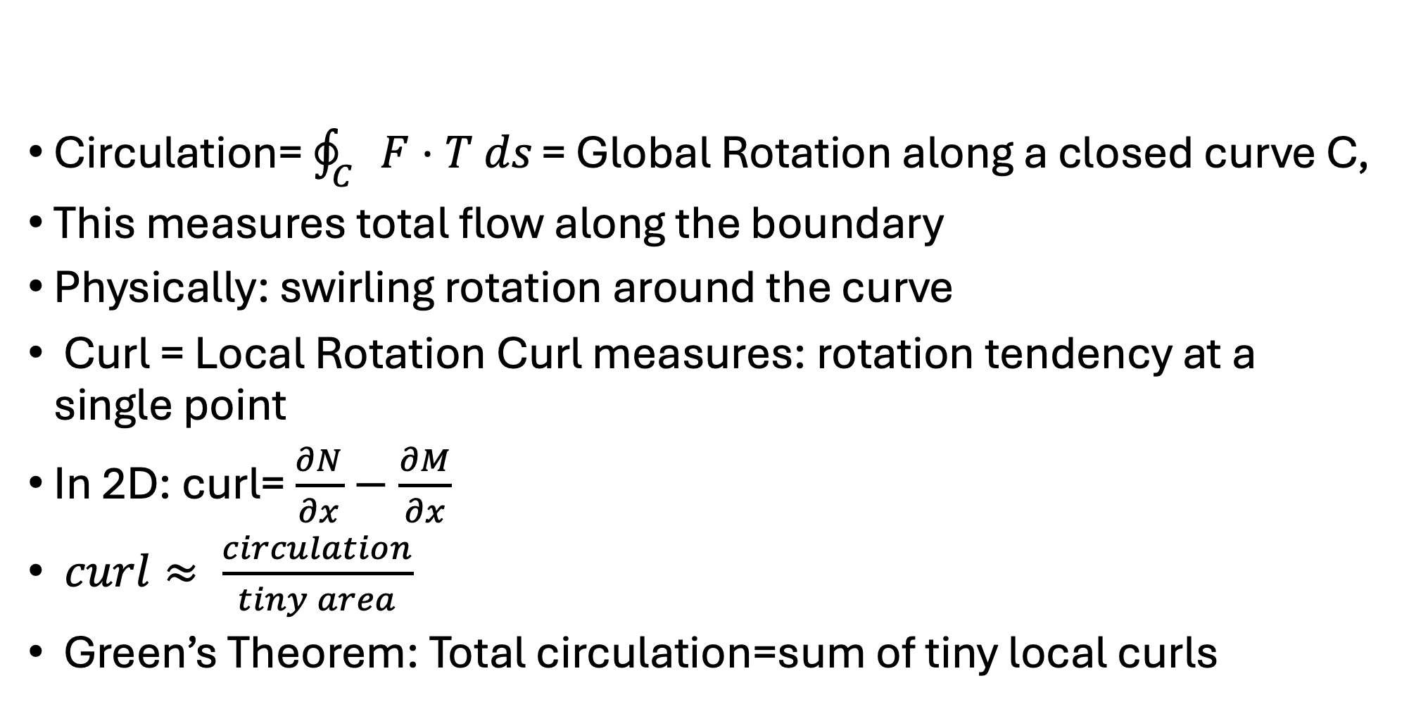
Circulation and Curl
Circulation= $\oint_{C}{F⋅T ds}​$= Global Rotation along a closed curve C,
This measures total flow along the boundary ​
Physically: swirling rotation around the curve
Curl = Local Rotation Curl measures: rotation tendency at a single point ​
In 2D: curl= $\frac{∂N}{∂x}−\frac{∂M}{∂x}$
$curl≈ \frac{circulation}{tiny area} ​$
Green’s Theorem: Total circulation=sum of tiny local curls ​

Slide 6
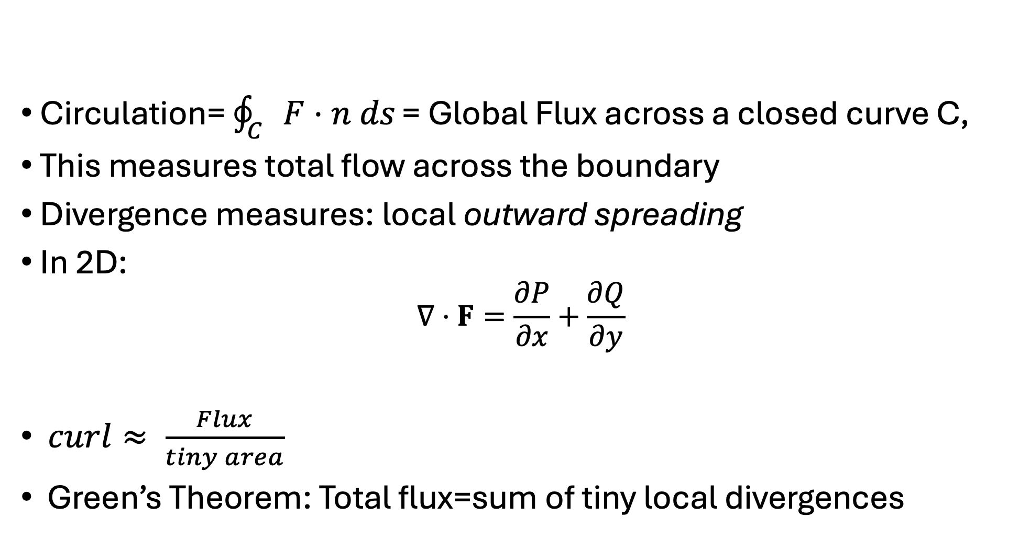
Flux and Divergence
Circulation= $\oint_{C}{F⋅n ds}​$= Global Flux across a closed curve C,
This measures total flow across the boundary ​
Divergence measures: $\text{local} \text{outward} \text{spreading}$
In 2D:
$$∇⋅F=\frac{∂P}{∂x}+\frac{∂Q}{∂y}$$
$curl≈ \frac{Flux}{tiny area} ​$
Green’s Theorem: Total flux=sum of tiny local divergences​

Slide 7
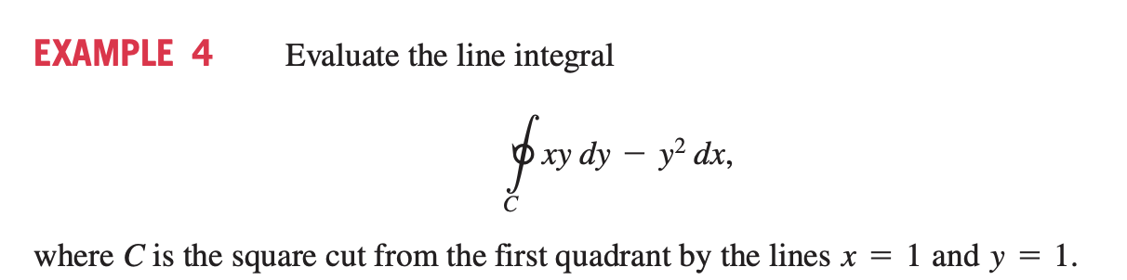
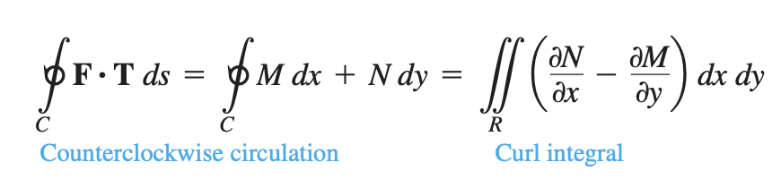
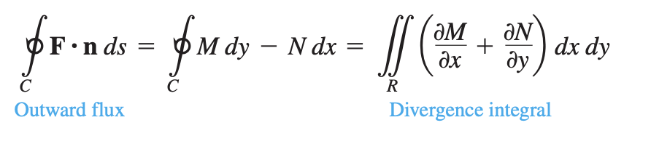

Slide 8
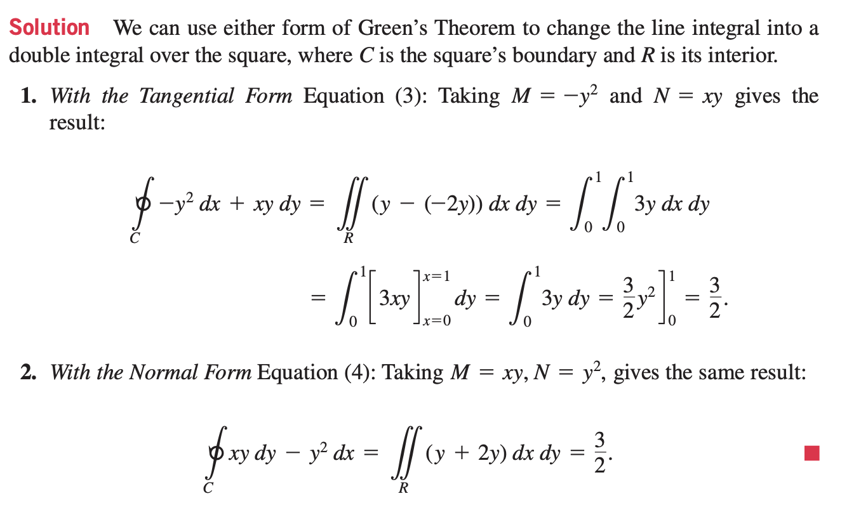

Slide 9
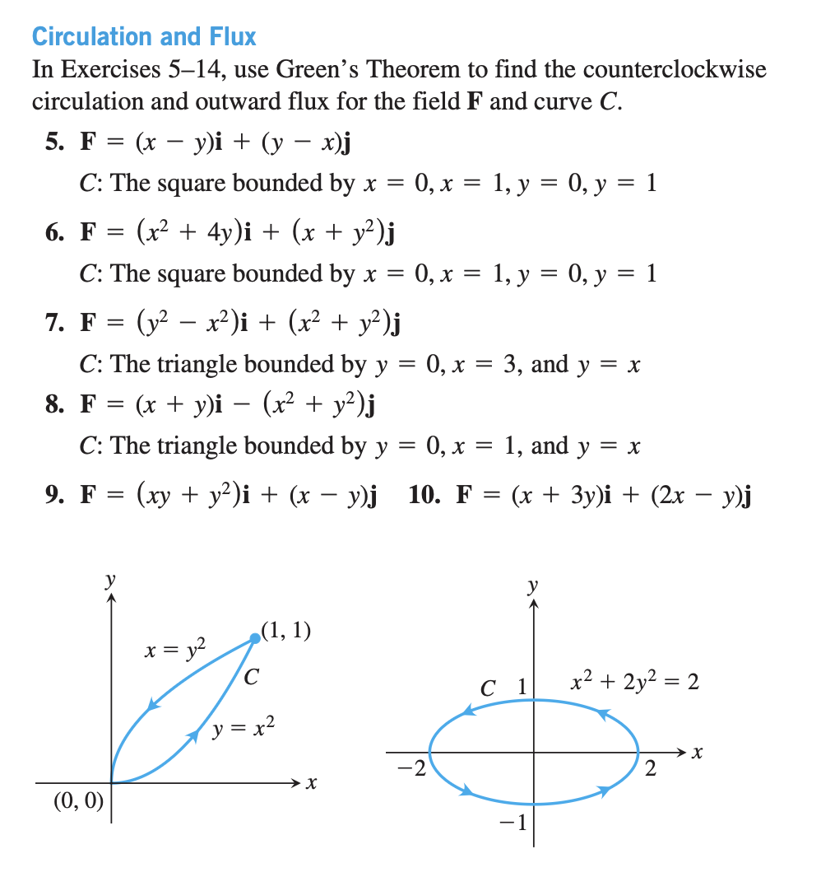

Slide 10
